Slide 1


ARTIFICIAL INTELLIGENCE
Unit-I: Introduction

Slide 2
Unit-I: Introduction
Introduction
AI problems, Agents and Environments
Structure of Agents, Problem Solving Agents
Basic Search Strategies
Problem Spaces
Uninformed Search (Breadth-First, Depth-First Search,
Depth-first with Iterative Deepening),
Heuristic Search (Hill Climbing, Generic Best-First, A*)

Slide 3
AI Role in Mechanical Engineering
Machine learning enables predictive monitoring, with machine learning algorithms forecasting equipment breakdowns in manufacturing units before they occur and scheduling timely maintenance.
Artificial intelligence (AI) is also being adopted for product inspection and quality control.
According to Forbes, automated quality testing done with machine learning can increase detection rates by up to 90%

Slide 4
AI Role in Mechanical Engineering
CIM (Computer Integrated Manufacturing such as (analysis, CAD, CAM, etc)) needs transparent communications as different systems handle the same object using different representations, thus requiring translation.
David (1987) discusses the requirements of an Intelligent CAD system, and introduces a system
called Ciao (Computer Intelligently Assisted Design).
AI Can assist in those scenarios.

Slide 6
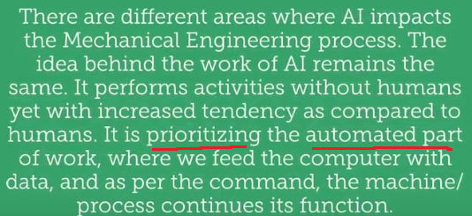
AI Role in Mechanical Engineering

Slide 7
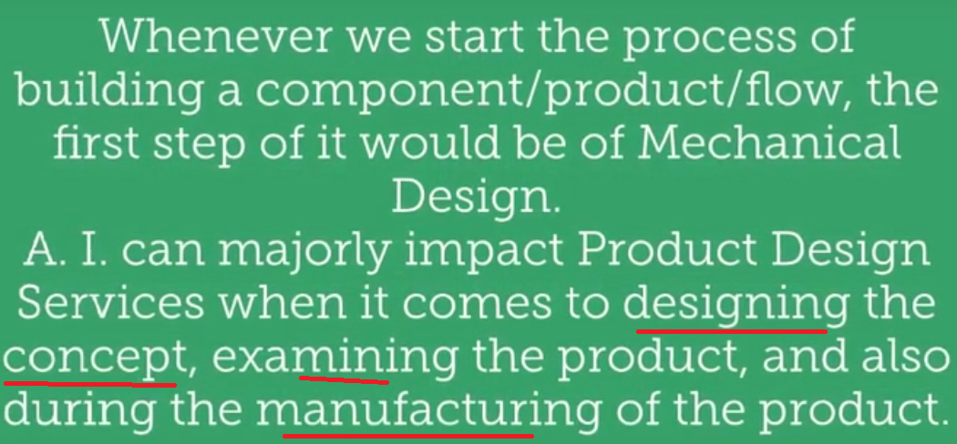
AI Role in Mechanical Engineering

Slide 8
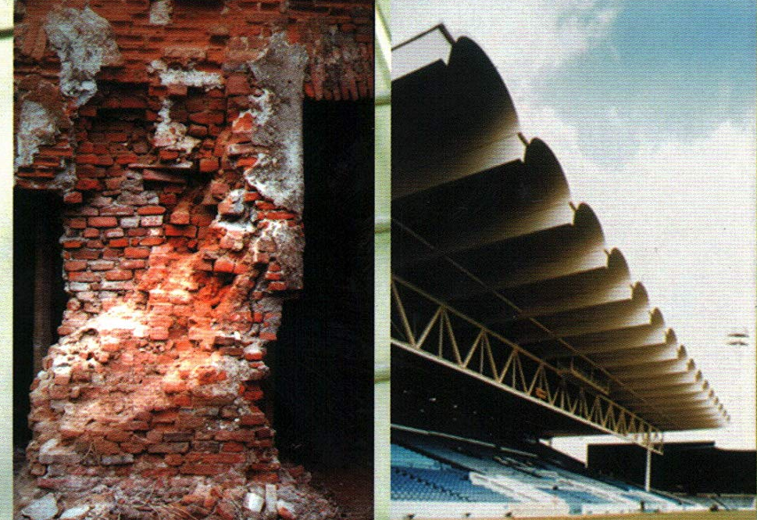
AI Role in Mechanical Engineering
Stress Elimination in 3D Structures
Estimating the amount of stress while designing and manufacturing 3D Structures
Material Evaluation for Different Services
Evaluating materials, its Strength-durability-quality and helping in a more exceptional manufacturing process

Slide 9
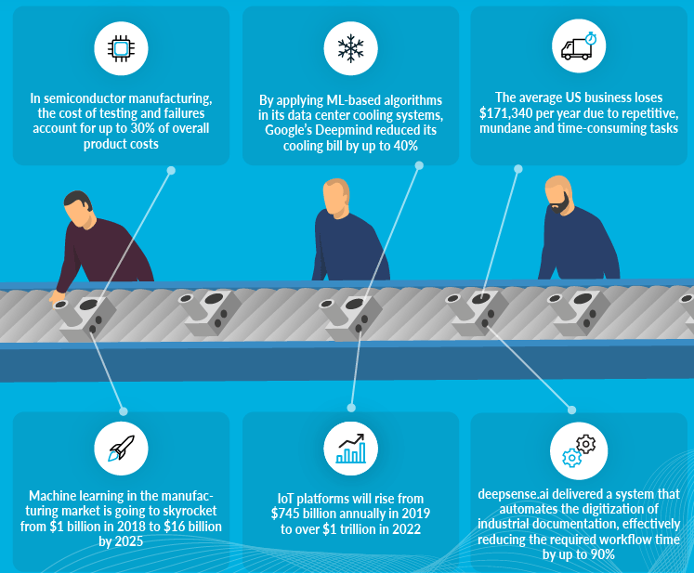
AI Role in Mechanical Engineering

Slide 10

Intelligence and Artificial Intelligence (AI)
Intelligence is the ability to acquire, understand and apply the knowledge to achieve goals in the world
Acquire → Understand → Apply ➔ GOAL
On the other hand, Artificial intelligence (AI) is the study of how to make computers do things which, at the moment, people do better

Slide 11
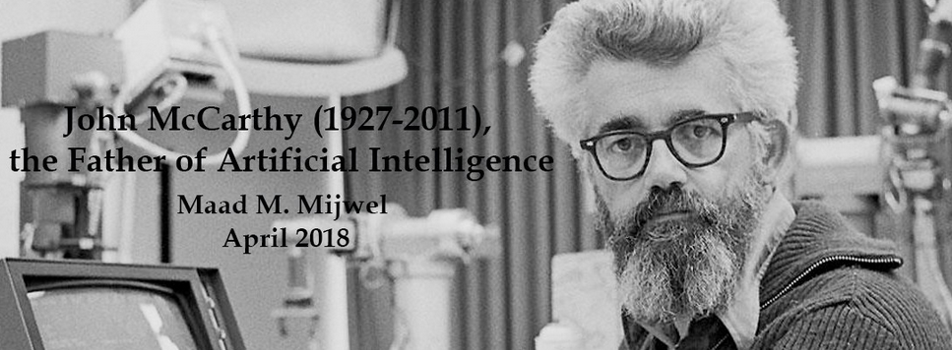
Artificial Intelligence (AI)
Artificial intelligence (AI) is the intelligence of machines and the branch of computer science which aims to create intelligent machines.
Artificial Intelligence is concerned with the design of intelligence in an artificial device.
The term was coined by McCarthy in 1956.

Slide 12

Artificial Intelligence (AI)
Artificial Intelligence is concerned with the design of intelligence in an artificial device.
There are two ideas in the definition.
1. Intelligence
2. artificial device
– A system with intelligence is expected to behave as intelligently as a human
– A system with intelligence is expected to behave in the best possible manner

Slide 13
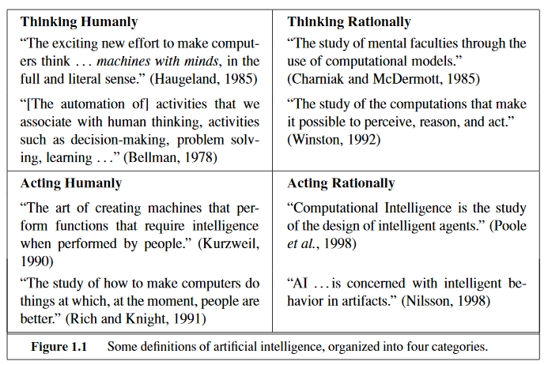
Definition of AI
Major AI textbooks define the field as
"the study and design of intelligent agents,“
where an intelligent agent is a system that perceives its environment and takes actions which maximize its chances of success.
Artificial intelligence is about designing systems that
are as intelligent as humans.

Slide 14
What is AI?
an attempt of
AI is the reproduction of human reasoning and intelligent behavior by computational methods
Intelligent
behavior
Computer
Humans

Slide 15
What is AI?
Discipline that systematizes and automates reasoning processes to create machines that:
Act like humans | Act rationally
Think like humans | Think rationally

Slide 16
Act like humans | Act rationally
Think like humans | Think rationally
The goal of AI is to create computer systems that perform tasks regarded as requiring intelligence when done by humans
→ AI Methodology: Take a task at which people are better, e.g.:
Prove a theorem
Play chess
Plan a surgical operation
Diagnose a disease
Navigate in a building
and build a computer system that does it automatically
But do we want to duplicate human imperfections?

Slide 17
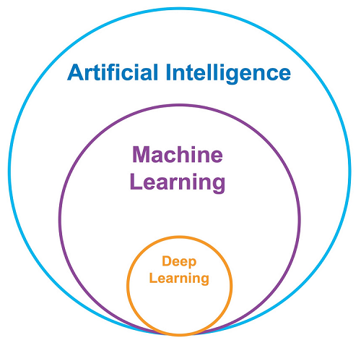

AI, ML and Deep Learning

Slide 18
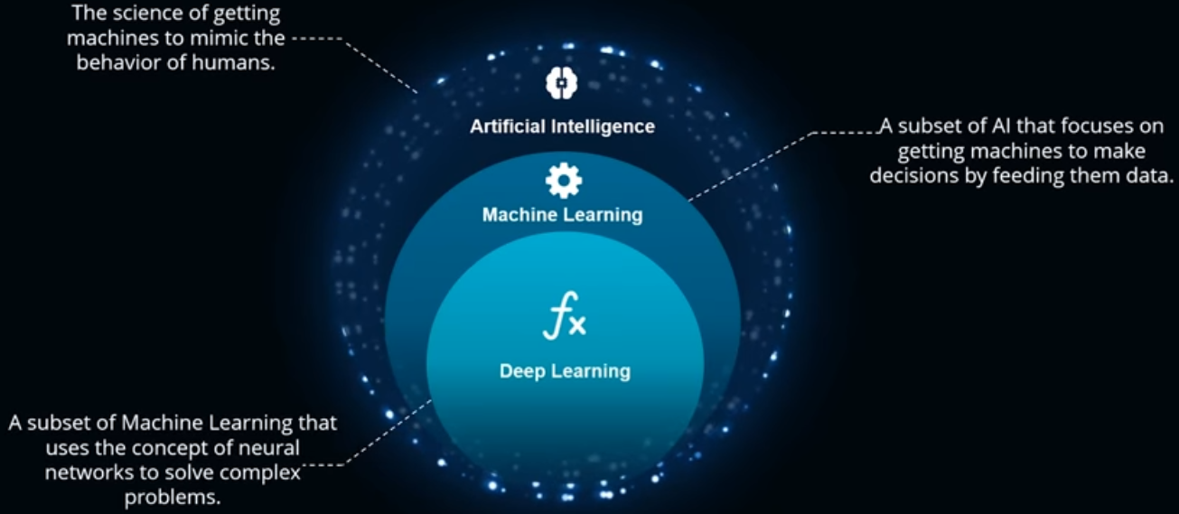
AI, ML and Deep Learning

Slide 19
What is Artificial Intelligence ?
NOTES
making computers that think?
the automation of activities we associate with human thinking, like decision making, learning ... ?
the art of creating machines that perform functions that require intelligence when performed by people ?
the study of mental faculties through the use of computational models ?

Slide 20
What is Artificial Intelligence ?
the study of computations that make it possible to perceive, reason and act ?
a field of study that seeks to explain and emulate intelligent behaviour in terms of computational processes ?
a branch of computer science that is concerned with the automation of intelligent behaviour ?
anything in Computing Science that we don't yet know how to do properly ? (!)

Slide 21
What is Artificial Intelligence ?
THOUGHT
Systems that think like humans
Systems that think rationally
Systems that act like humans
Systems that act rationally
BEHAVIOUR
HUMAN
RATIONAL

Slide 22
Turing Test: Systems that act like humans
“The art of creating machines that perform functions that require intelligence when performed by people.” (Kurzweil)
“The study of how to make computers do things at which, at the moment, people are better.” (Rich and Knight)

Slide 23
Systems that act like humans
?
You enter a room which has a computer terminal. You have a fixed period of time to type what you want into the terminal, and study the replies. At the other end of the line is either a human being or a computer system.
If it is a computer system, and at the end of the period you cannot reliably determine whether it is a system or a human, then the system is deemed to be intelligent.

Slide 24
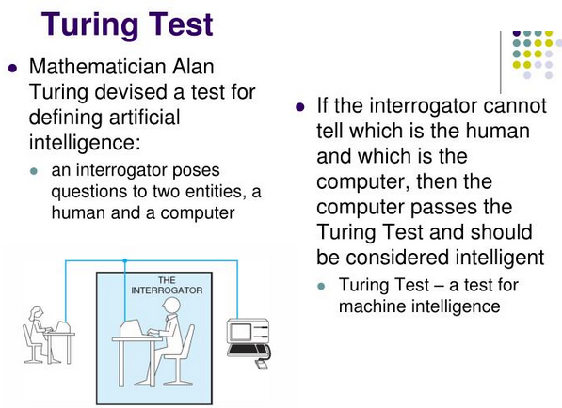
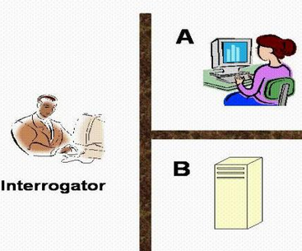
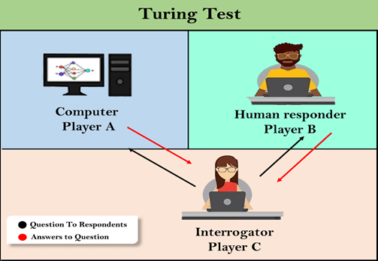

Slide 25
The Total Turing Test
Includes two more issues:
Computer vision
to perceive objects (seeing)
Robotics
to move objects (acting)

Slide 26
Systems that act like humans
The Turing Test approach
a human questioner cannot tell if
there is a computer or a human answering his question, via teletype (remote communication)
The computer must behave intelligently
Intelligent behavior
to achieve human-level performance in all cognitive tasks

Slide 27
Systems that act like humans
These cognitive tasks include:
Natural language processing
for communication with human
Knowledge representation
to store information effectively & efficiently
Automated reasoning
to retrieve & answer questions using the stored information
Machine learning
to adapt to new circumstances

Slide 28
AI problems/What can AI do today?
While studying the typical range of tasks that we might expect an “intelligent entity” to perform, we need to consider both “common-place/Mundane/routine tasks as well as expert tasks.
Mundane tasks: (daily use tasks)
Planning route, activity
Recognizing people, objects (vision, speech)
Communicating (through natural language)
Navigating around obstacles on the street.

Slide 29
AI problems (cont..)
Expert Tasks
Medical diagnosis
Mathematical problem solving
Playing games like chess
Easy /Hard Problems: It has been easier to mechanize many of the high level tasks (expert). We usually associate with the intelligence in people, in history we don’t have same amount of success with mundane tasks.

Slide 30
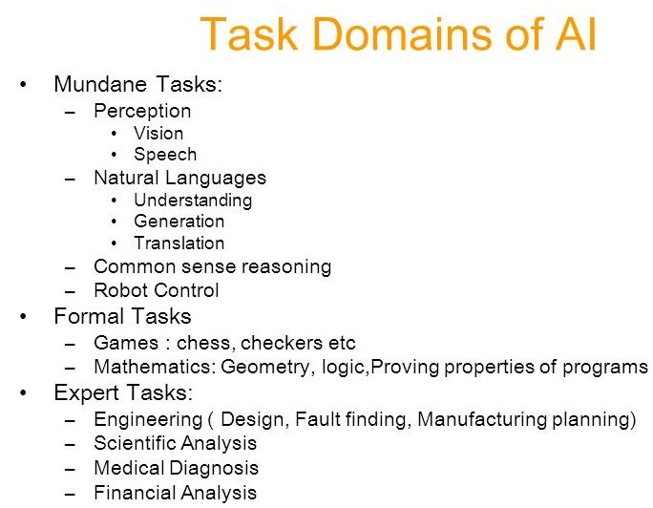
AI Problems

Slide 31
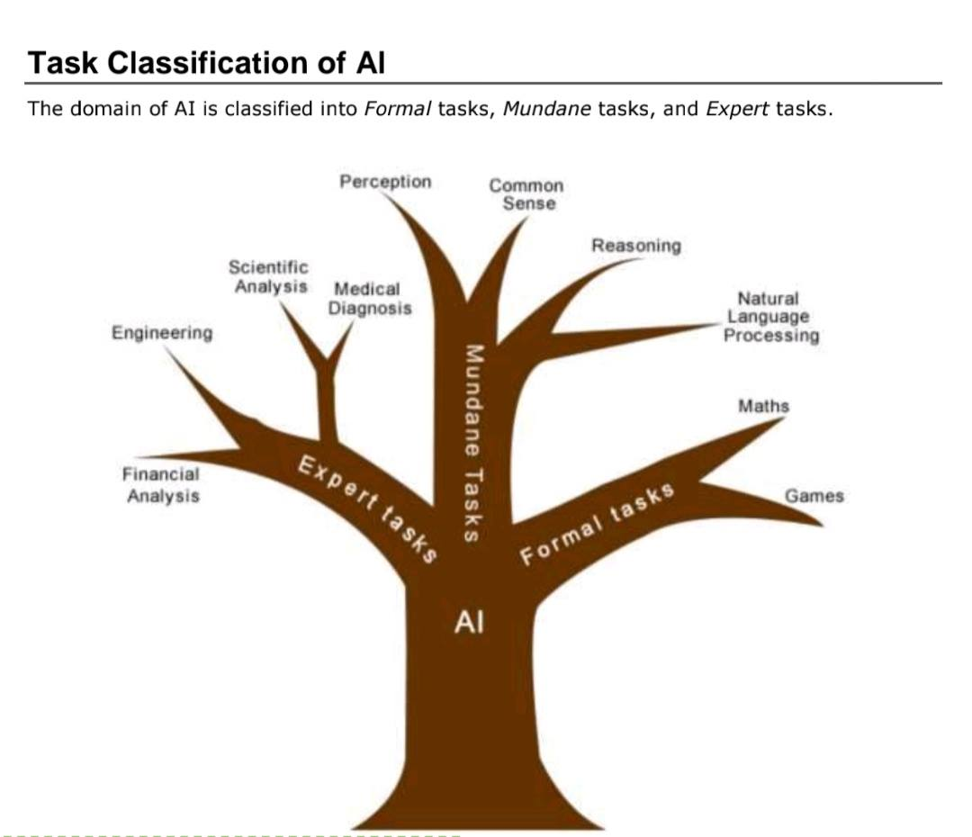
AI Problems

Slide 32
AI problems (cont..)
AI Systems can easily do
Symbolic integration
Proving theorems
Playing chess
Medical Diagnosis
It has been very hard to mechanize tasks that lot of animals do
Walking around without running into things
Catching Prey and avoiding predators
Interpreting complex sensory information
Modeling the internal states of other animals from their behavior.
(lists, hierarchies, or networks)

Slide 33
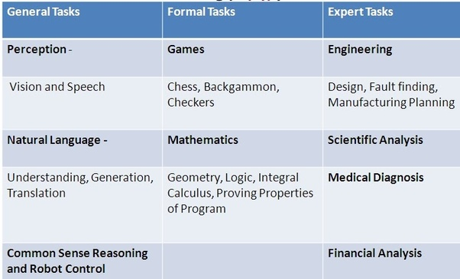

AI problems (cont..)
Processing

Slide 34
AI problems (cont..)
Humans have learned mundane (ordinary) tasks since their birth.
They learn by perception, speaking, using language, and locomotives.
They learn Formal Tasks and Expert Tasks later, in that order.
For humans, the mundane tasks are easiest to learn. The same was considered true before trying to implement mundane tasks in machines.

Slide 35
AI problems (cont..)
Earlier, all work of AI was concentrated in the mundane task domain.
Later, it turned out that the machine requires more knowledge, complex knowledge representation, and complicated algorithms for handling mundane tasks.
This is the reason why AI work is more prospering in the Expert Tasks domain now, as the expert task domain needs expert knowledge without common sense, which can be easier to represent and handle.

Slide 36
FYI on AI
Limits of AI Today
Today’s successful AI systems operate in well-defined domains and employ narrow, specialized knowledge.
Common sense knowledge is needed to function in complex, open-ended worlds. Such a system also needs to understand unconstrained natural language. However these capabilities are not yet fully present in today’s intelligent systems.
What can AI systems do
Today’s AI systems have been able to achieve limited success in some of these tasks.
• In Computer vision, the systems are capable of face recognition
• In Robotics, we have been able to make vehicles that are mostly autonomous.
• In Natural language processing, we have systems that are capable of simple machine translation.
• Today’s Expert systems can carry out medical diagnosis in a narrow domain
• Speech understanding systems are capable of recognizing several thousand words continuous speech

Slide 37
FYI on AI
Planning and scheduling systems had been employed in scheduling experiments with the Hubble Telescope.
The Learning systems are capable of doing text categorization into about a 1000 topics
In Games, AI systems can play at the Grand Master level in chess (world champion), checkers, etc.
What can AI systems NOT do yet?
• Understand natural language robustly (e.g., read and understand articles in a newspaper)
• Surf the web
• Interpret an arbitrary visual scene
• Learn a natural language
• Construct plans in dynamic real-time domains
• Exhibit true autonomy and intelligence

Slide 38
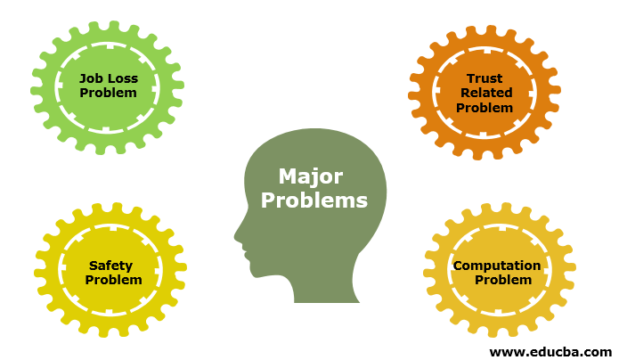
Disadvantage with AI

Slide 39
FYI: Today’s AI Applications
AI to analyze satellite images to identify which areas have the highest poverty levels
New Artificial Intelligence now predicts the time it takes for a crop like a tomato to be ripe and ready for picking thus increasing the efficiency of farming.
AI researchers have created many tools in AI laboratories to solve the most difficult problems in computer science. Thus include computer mouse, GUIs, Automatic storage management..etc.
Computer-aided interpretation of medical images : A typical application is detection of the tumor.
Artificial Intelligence have been combined with many sensor technologies which enables many applications such as at home water quality monitoring.
Chat bots in Food order Apps.

Slide 40
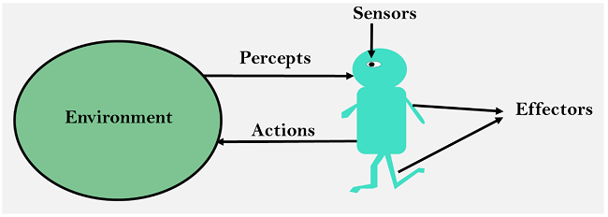
Agents & Environments in AI
An AI system can be defined as the study of the rational agent and its environment.
The agents sense the environment through sensors and act on their environment through actuators.
An AI agent can have mental properties such as knowledge, belief, intention, etc.
No Emotions and only
Math based

Slide 41
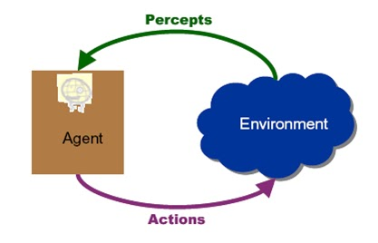
Agents & Environments in AI
An AI system can be defined as the study of the rational agent and its environment.
The agents sense the environment through sensors and act on their environment through actuators.
An AI agent can have mental properties such as knowledge, belief, intention, etc.
No Emotions and only
Math based
A rational agent
- is said to perform the right things
- which has clear preference, models uncertainty, and
acts in a way to maximize its performance measure with all possible actions

Slide 42
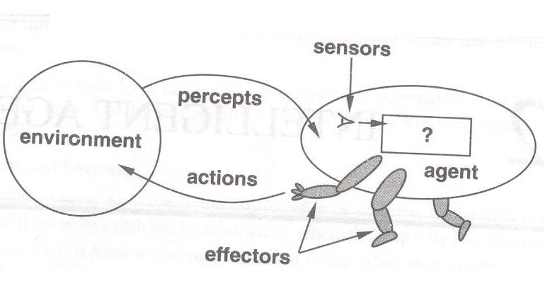
Agents & Environments
An agent can be anything that perceive its environment
through sensors and act upon that environment through actuators.
An Agent runs in the cycle of perceiving, thinking, and acting.

Slide 43
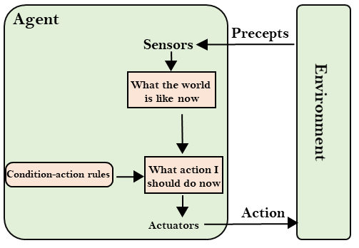
FYI: Definitions
Agent: An agent is anything that can perceive its environment through sensors and acts upon that environment through effectors.
Environment: An environment is the surroundings or conditions in which an agents lives or operates.
Action: An action is operation involving the effectors.(Actuator).

Slide 44
Working of Agent on Environment
An agent perceives its environment through sensors.
The complete set of inputs at a given time is called a percept.
The current percept, or a sequence of percepts can influence the actions of an agent.
The agent can change the environment through actuators or effectors.
An operation involving an effector is called an action.
Actions can be grouped into action sequences.
The agent can have goals which it tries to achieve.
Thus, an agent can be looked upon as a system that implements a mapping from percept sequences to actions.

Slide 45
What is AI Agent?
An agent can be anything that perceive its environment through sensors and act upon that environment through actuators.
An Agent runs in the cycle of perceiving, thinking, and acting. An agent can be:
Human-Agent: A human agent has eyes, ears, and other organs which work for sensors and hand, legs, vocal tract work for actuators.
Robotic Agent: A robotic agent can have cameras, infrared range finder, Natural Lang. processor (NLP) for sensors and various motors for actuators.
Software Agent: Software agent can have keystrokes, file contents as sensory input and act on those inputs and display output on the screen.

Slide 46
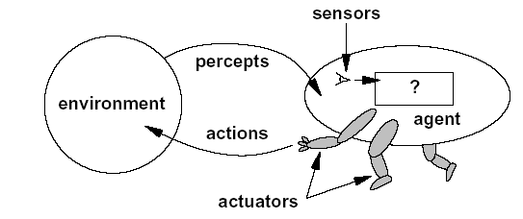
In other words….Agents
A human agent has :
Sensors: eyes, ears, and other organs.
Actuator: hands, legs, mouth, and other body part.
A robotic agent might have:
Sensors: Cameras,..
Actuator: motors
A Software Agent
Sensors: ?
Actuator: ?
The agent function
maps from percepts histories to actions
F: P→ A

Slide 47
Example: Vacuum Cleaner
There are two locations: squares A and B.
The vacuum agent perceives which square it is in and whether there is dirt in the square.
It can choose to move left, move right, suck up the dirt, or do nothing.
One very simple agent function is the following: if the current square is dirty, then suck, otherwise move to the other square.
A partial tabulation of this agent function is shown in below Figure

Slide 48
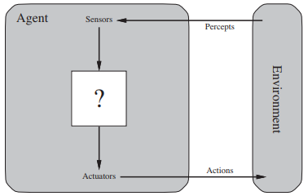
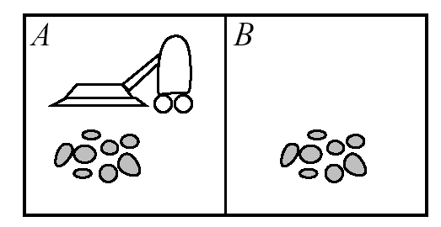
Example: Vacuum Cleaner
Agent: vacuum cleaner
Environment: Front room
Percept: See dirt ( Eye of the vacuum cleaner)
Action: Suck the dirt (Attached components of vacuum cleaner
Change in the Environment: Front room is clean

Slide 49
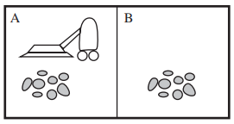
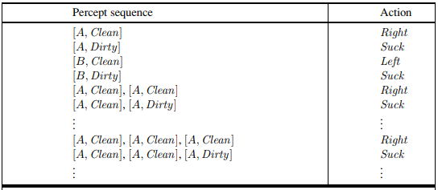
A Vacuum cleaner world with just two locations

Slide 50
Example: Vacuum Cleaner Agent
Agent: robot vacuum cleaner
Environment: floors of your apartment
Sensors:
dirt sensor: detects when floor in front of robot is dirty
bump sensor: detects when it has bumped into something
power sensor: measures amount of power in battery
bag sensor: amount of space remaining in dirt bag
Effectors:
motorized wheels
suction motor
plug into wall? empty dirt bag?
Percepts: “Floor is dirty”
Actions: “Forward, 0.5 ft/sec”

Slide 51

Vacuum Cleaner Agent

Slide 52
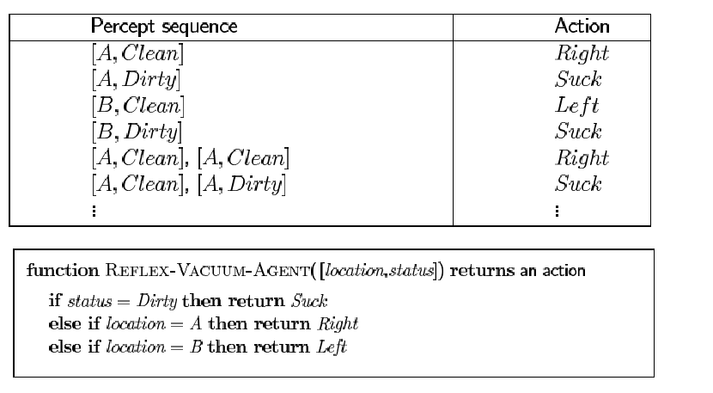
Vacuum Cleaner Agent

Slide 53
Structure of AI Agents
The job of AI is to design an agent program that implements the agent function—
(ie., the mapping from percepts to→ actions)
We assume this program will run on some sort of ARCHITECTURE computing device with physical sensors and actuators—we call this the architecture:
agent = architecture + program

Slide 54
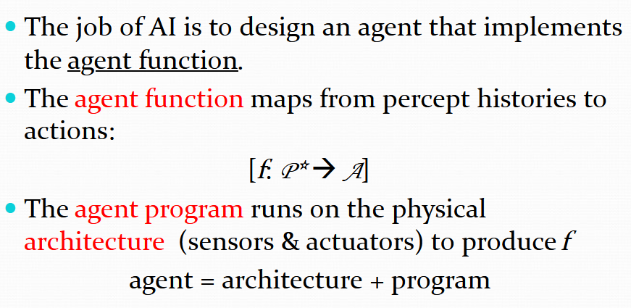
In other Words… Structure of AI Agents

Slide 55
Structure of AI Agents
Following are the main three terms involved in the structure of an AI agent:
Architecture: Architecture is machinery that an AI agent executes on.
Agent Function: Agent function is used to map a percept (P*) to an action (A).
f : P* → A
Agent program: Agent program is an
implementation of agent function.
An agent program executes on the physical architecture to produce function f.

Slide 56
Structure of AI Agents
Obviously, the program we choose has to be one that is appropriate for the architecture.
If the program is going to recommend actions like Walk, the architecture had better have legs.
The architecture might be just an ordinary PC, or it might be a robotic car with several onboard computers, cameras, and other sensors.
In general, the architecture makes the percepts from the sensors available to the program, runs the program, and feeds the program’s action choices to the actuators as they are generated.

Slide 57
Types of AI Agents
Types of AI Agent | Agent Working Process
State-based Agent or model-based reflex agent | information comes from sensors - percepts based on this, the agent changes the current state of the world based on state of the world and knowledge (memory), it triggers actions through the effectors
Goal-based Agent | See Next Slide
Utility-based Agent | Utility based agents provides a more general agent framework. In case that the agent has multiple goals, this framework can accommodate different preferences for the different goals. Such systems are characterized by a utility function that maps a state or a sequence of states to a real valued utility. The agent acts so as to maximize expected utility
Simple reflex agents | Select actions on the basis of current percept only Condition-action rule: if car-in-front-is-braking then initiate-braking
Learning Agent | Learning allows an agent to operate in initially unknown environments. The learning element modifies the performance element. Learning is required for true autonomy.

Slide 58
Goal-Based Agent
State-based Agent or model-based reflex agent
which base their actions on a direct mapping from states to actions.
Such agents cannot operate well in environments for which this mapping would be too large to store and would take too long to learn.
Goal-based agents, on the other hand, consider future actions and the desirability of their outcomes.

Slide 59
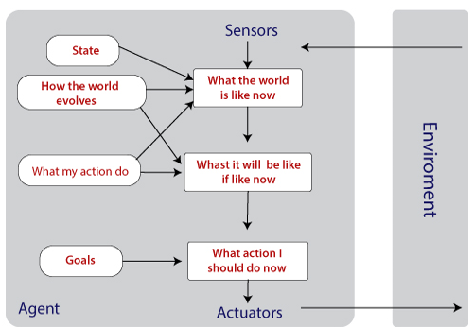
Goal-Based Agent
In some cases, just knowing the information is not sufficient.
The intent is to reduce distance from the goal, i.e., desired situations.
Knowledge about the goal is an important factor.
They are used to expand the capabilities based on the goal information.

Slide 60
Goal-Based Agent
The goal based agent has some goal which forms a basis of its actions. Such agents work as follows:
information comes from sensors - percepts
changes the agents current state of the world
based on state of the world and knowledge (memory) and goals/intentions, it chooses actions and does them through the effectors.
Goal formulation based on the current situation is a way of solving many problems and search is a universal problem solving mechanism in AI.
The sequence of steps required to solve a problem is not known a priori (from the former) and must be determined by a systematic exploration of the alternatives.

Slide 61
Problem-Solving Agents
In Artificial Intelligence, Search techniques are universal problem-solving methods.
Rational agents (one that does the right thing) or Problem-solving agents in AI mostly used these search strategies or algorithms to solve a specific problem and provide the best result.
Problem-solving agents are the goal-based agents and use atomic representation (each state of the world is a black box that has no internal structure).

Slide 62
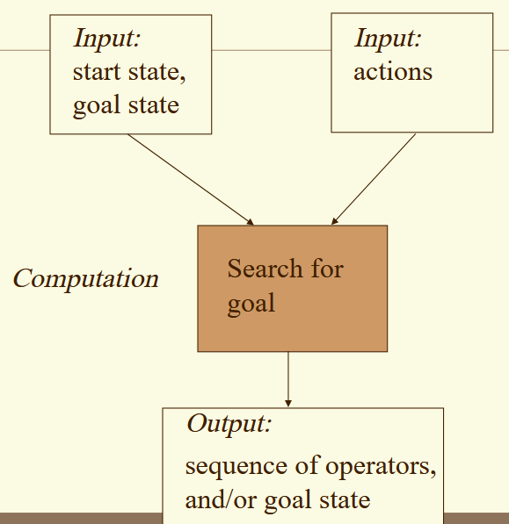
Problem-Solving Agent

Slide 63
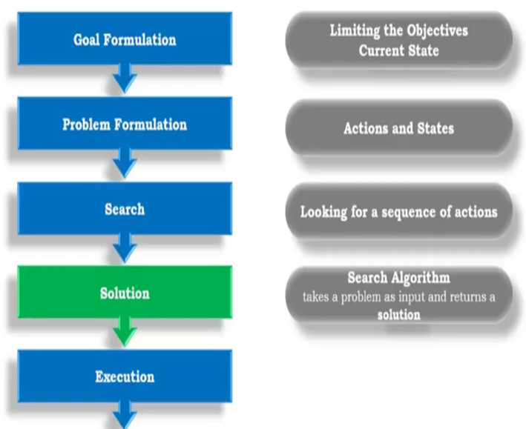
Problem-Solving Agent

Slide 64
Problem Solving Agent
A Problem Solving has a GOAL
Then the Agent Calls a Search procedure to solve it
Problem Solving is a kind of Goal-based Agent that decides What to do by finding the sequences of Actions that lead to desirable states
An Intelligent Agent case, a Knowledge Base (KB) corresponds to the environment operators correspond to sensors and the search techniques are the Actuators

Slide 65
Problem-Solving Agent
Steps Performed by Problem Solving Agent | Explanation
Goal Formulation | It organizes the steps/sequence required to formulate one goal out of multiple goals as well as actions to achieve that goal. Goal formulation is based on the current situation and the agent’s performance measure.
Problem Formulation | It is the most important step of problem-solving which decides what actions should be taken to achieve the formulated goal.
Search | It identifies all the best possible sequence of actions to reach the goal state from the current state. It takes a problem as an input and returns solution as its output.
Solution | It finds the best algorithm out of various algorithms, which may be proven as the best optimal solution.
Execution | It executes the best optimal solution from the searching algorithms to reach the goal state from the current state.

Slide 66
Problem Formulation
This decides what actions should be taken to achieve the formulated goal.
There are following five components involved in problem formulation:
Initial State: It is the starting state or initial step of the agent towards its goal.
Actions: It is the description of the possible actions available to the agent.
Transition Model: It describes what each action does.
Goal Test: It determines if the given state is a goal state.
Path cost: It assigns a numeric cost to each path that follows the goal. The problem-solving agent selects a cost function, which reflects its performance measure.
Remember, an optimal solution has the lowest path cost among all the solutions.

Slide 67
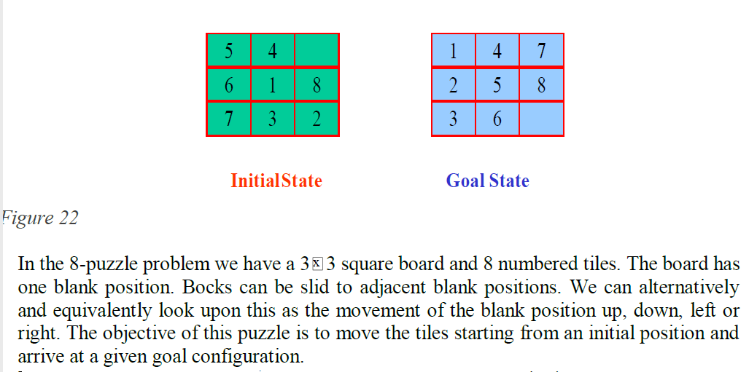
Example: 8 puzzle

Slide 68
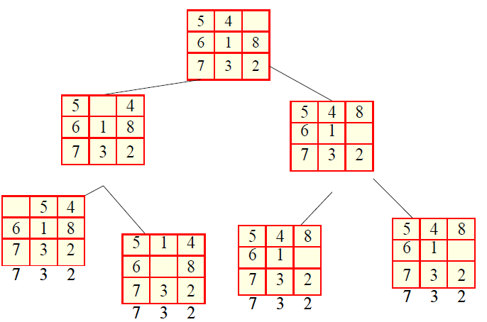
Example: 8 puzzle

Slide 69
Example: 8 puzzle
The problem formulation is as follows:
States: It describes the location of each numbered tiles and the blank tile.
Initial State: We can start from any state as the initial state.
Actions: Here, actions of the blank space is defined, i.e., either left, right, up or down
Transition Model: It returns the resulting state as per the given state and actions.
Goal test: It identifies whether we have reached the correct goal-state.
Path cost: The path cost is the number of steps in the path where the cost of each step is 1.

Slide 70
Search Algorithm Technologies
Problem-solving agents in AI mostly used these search strategies or algorithms to solve a specific problem and provide the best result.
Search: Searching is a step by step procedure to solve a search-problem in a given search space.
A search problem can have three main factors:
Search Space: Search space represents a set of possible solutions, which a system may have.
Start State: It is a state from where agent begins the search.
Goal test: It is a function which observe the current state and returns whether the goal state is achieved or not.

Slide 71
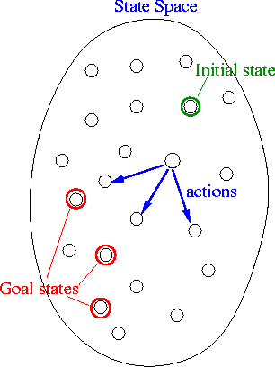
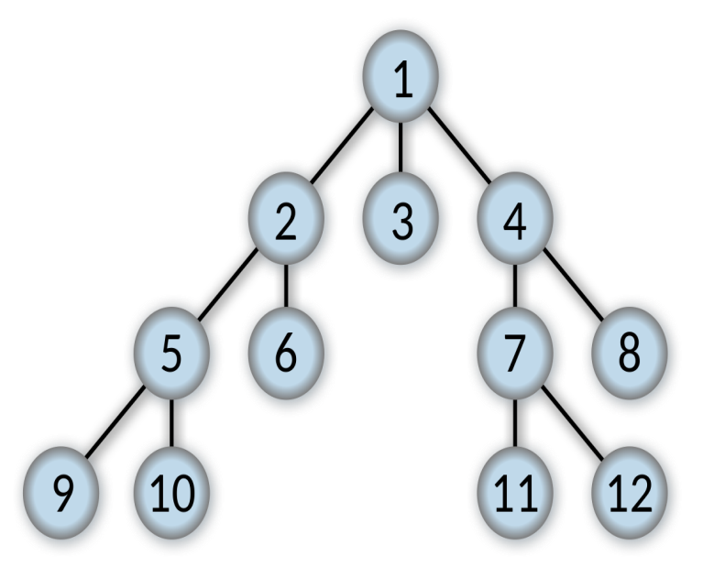
Search Algorithm Technologies
State Space: A state space represents a problem in terms of states and operators that change states
Start State: It is a state from where agent begins the search.
Goal test: It is a function which observe the current state and returns whether the goal state is achieved or not.
Search tree: A tree representation of search problem is called Search tree. The root of the search tree is the root node which is corresponding to the initial state.

Slide 72
Search Algorithm Technologies
Actions: It gives the description of all the available actions to the agent.
Transition model: A description of what each action do, can be represented as a transition model.
Path Cost: It is a function which assigns a numeric cost to each path.
Solution: It is an action sequence which leads from the start node to the goal node.
Optimal Solution: If a solution has the lowest cost among all solutions.

Slide 73
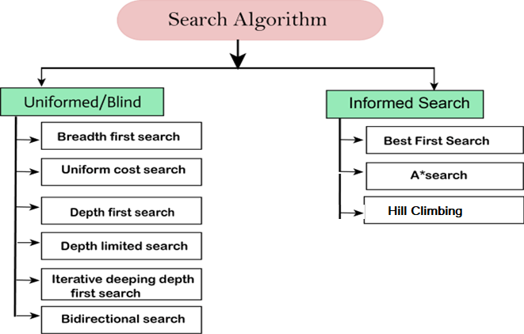
Types of search algorithms
Based on the search problems we can classify the search algorithms into uninformed (Blind search) search and informed search (Heuristic search) algorithms.

Slide 74
Problem Space
The problem space may contain one or more solutions.
A solution is a combination of operations and objects that achieve the goals.
A problem space encompasses all valid states that can be generated by the application of any combination of operators on any combination of objects.
Problem solving is a process of generating solutions from observed data.
A ‘problem’ is characterized by
• a set of goals,
• a set of objects,
• a set of
operations

Slide 75

Uninformed/Blind Search
The uninformed search does not contain any domain knowledge such as closeness, the location of the goal.
It operates in a brute-force way as it only includes information about how to traverse the tree and how to identify leaf and goal nodes.
Uninformed search applies a way in which search tree is searched without any information about the search space like initial state operators and test for the goal, so it is also called blind search.
It examines each node of the tree until it achieves the goal node.

Slide 76
Informed Search
The Informed Search (or Heuristic Search) is searching with “information” about the goal node.
For example, in the A* search algorithm, first, we gather information about the goal node such as its location in cartesian coordinate form and then we write a function that can guide our node traversal, for example, finding its Euclidean distance, also this function is called Heuristic Function.
The heuristic function will guide our node traversal by stating the distance left from each node to the goal node.
You can also think of Informed Search Strategy as a Guided Search Strategy.

Slide 77
Informed Search
Informed search algorithms use domain knowledge. In an informed search, problem information is available which can guide the search. Informed search strategies can find a solution more efficiently than an uninformed search strategy. Informed search is also called a Heuristic search.
A heuristic is a way which might not always be guaranteed for best solutions but guaranteed to find a good solution in reasonable time.
Informed search can solve much complex problem which could not be solved in another way.
An example of informed search algorithms is a traveling salesman problem.
Greedy Search
A* Search

Slide 78
Blind Search: Breadth-first Search
Breadth-first search is the most common search strategy for traversing a tree or graph.
This algorithm searches breadthwise in a tree or graph, so it is called breadth-first search.
BFS algorithm starts searching from the root node of the tree and expands all successor node at the current level before moving to nodes of next level.
The breadth-first search algorithm is an example of a general-graph search algorithm.
Breadth-first search implemented using FIFO (First-In-First-Out) queue data structure.

Slide 79
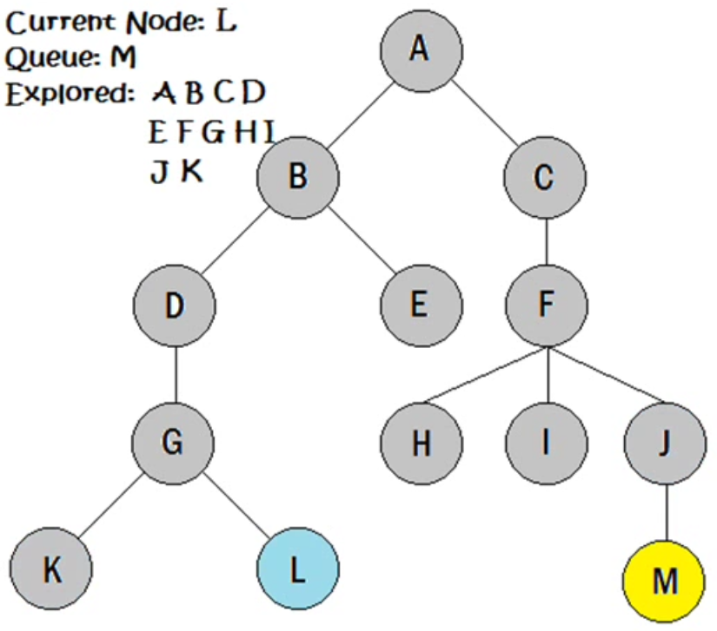
Breadth-first Search

Slide 80
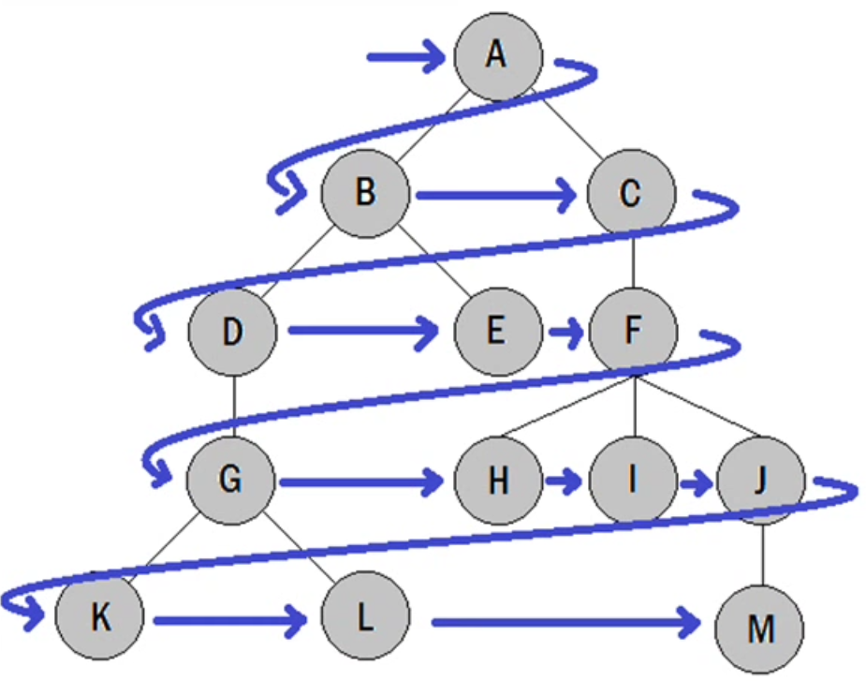
Breadth-first Search

Slide 81
Breadth-first Search
Example:
In the below tree structure, we have shown the traversing of the tree using BFS algorithm from the root node S to goal node K.
BFS search algorithm traverse in layers, so it will follow the path which is shown by the dotted arrow, and the traversed path will be:
S---> A-->B--->C-->D--->G-->H-->E-->F-->I---->K

Slide 82
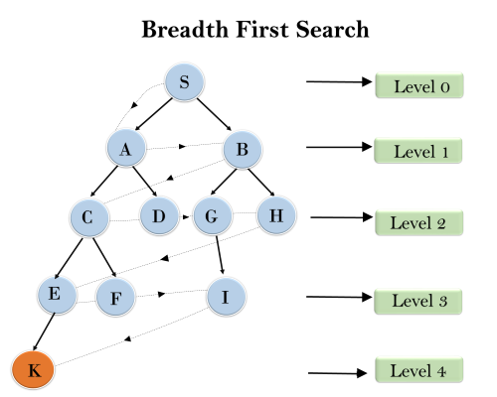
Breadth-first Search
S---> A-->B--->C-->D--->G-->H-->E-->F-->I---->K

Slide 83
Depth-first Search
Depth-first search is a recursive algorithm for traversing a tree or graph data structure.
It is called the depth-first search because it starts from the root node and follows each path to its greatest depth node before moving to the next path.
DFS uses a stack data structure for its implementation.
The process of the DFS algorithm is similar to the BFS algorithm.
Stack: Consider an example of plates stacked over one another in the canteen.
The plate which is at the top is the first one to be removed, i.e. the plate which has been placed at the bottommost position remains in the stack for the longest period of time. So, it can be simply seen to follow LIFO(Last In First Out)/
FILO(First In Last Out) order.

Slide 84
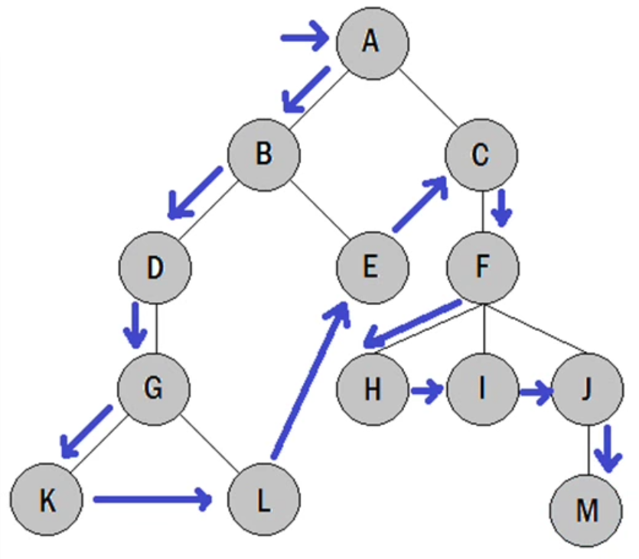
Depth-first Search

Slide 85
Depth-first Search: Example
In the below search tree, we have shown the flow of depth-first search, and it will follow the order as:
Root node--->Left node ----> right node.
It will start searching from root node S, and traverse A, then B, then D and E, after traversing E, it will backtrack the tree as E has no other successor and still goal node is not found.
After backtracking it will traverse node C and then G, and here it will terminate as it found goal node.

Slide 86
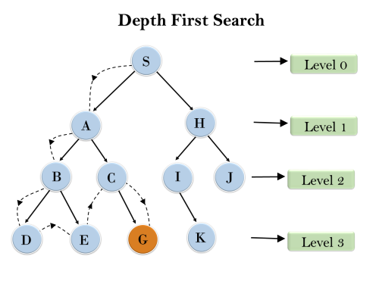
Depth-first Search: Example

Slide 87
Depth-first with Iterative Deepening
The iterative deepening algorithm is a combination of BFS and DFS algorithms.
This search algorithm finds out the best depth limit and does it by gradually increasing the limit until a goal is found.
This algorithm performs depth-first search up to a certain "depth limit", and it keeps increasing the depth limit after each iteration until the goal node is found.
This Search algorithm combines the benefits of Breadth-first search's fast search and depth-first search's memory efficiency.
The iterative search algorithm is useful uninformed search when search space is large, and depth of goal node is unknown.

Slide 88
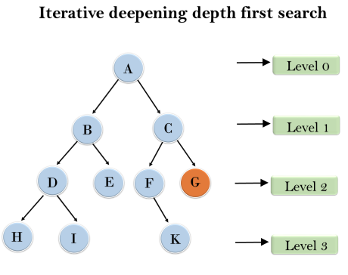
Depth-first with Iterative Deepening (DFIDS): Example
Following tree structure is showing the iterative deepening depth-first search (DFIDS).
DFIDS algorithm performs various iterations until it does not find the goal node. The iteration performed by the algorithm is given as:
1'st Iteration-----> A 2'nd Iteration----> A, B, C 3'rd Iteration------>A, B, D,
E, C, F, G 4'th Iteration------>A, B, D, H, I, E, C, F, K, G
In the fourth iteration, the algorithm will find the goal node.

Slide 89
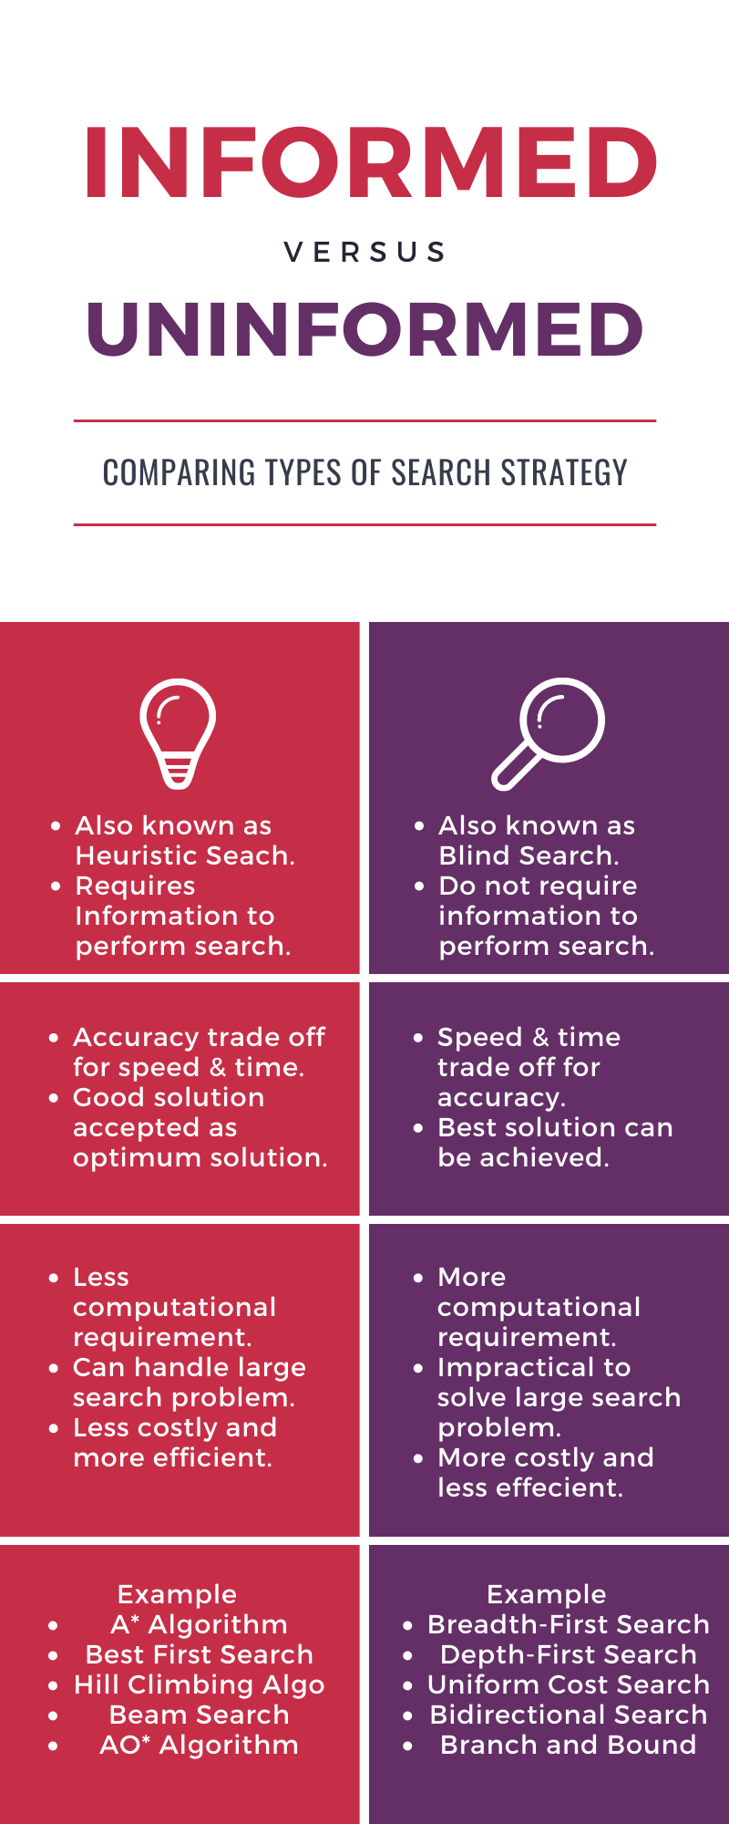

Slide 90
Informed / Heuristic Search
Informed search algorithm contains an array of knowledge such as how far we are from the goal, path cost, how to reach to goal node, etc.
This knowledge help agents to explore less to the search space and find more efficiently the goal node.
The informed search algorithm is more useful for large search space.
Informed search algorithm uses the idea of heuristic, so it is also called Heuristic search.
Heuristic: Find or Discover

Slide 91
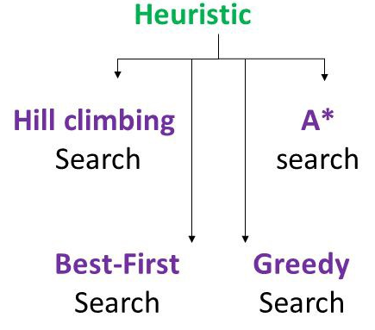
Informed / Heuristic Search

Slide 92
Hill Climbing
Hill Climbing is a form of heuristic search algorithm which is used in solving optimization related problems in AI domain.
Searching for a goal state = Climbing to the top of a hill
- Generate-and-test + direction to move.
- Heuristic function to estimate how close a given
state is to a goal state.
Generate-and-Test Algorithm
1. Generate a possible solution.
2. Test to see if this is actually a solution.
3. Quit if a solution has been found. Otherwise, return to
step 1.

Slide 93
Hill Climbing
The algorithm starts with a non-optimal state and iteratively improves its state until some predefined condition is met.
The condition to be met is based on the heuristic function. (Heuristic function estimates how close a state is to the goal).
The aim of the algorithm is to reach an optimal state which is better than its current state.
The starting point which is the non-optimal state is referred to as the base of the hill and it tries to constantly iterate (climb) untill it reaches the peak value, that is why it is called Hill Climbing Algorithm

Slide 94

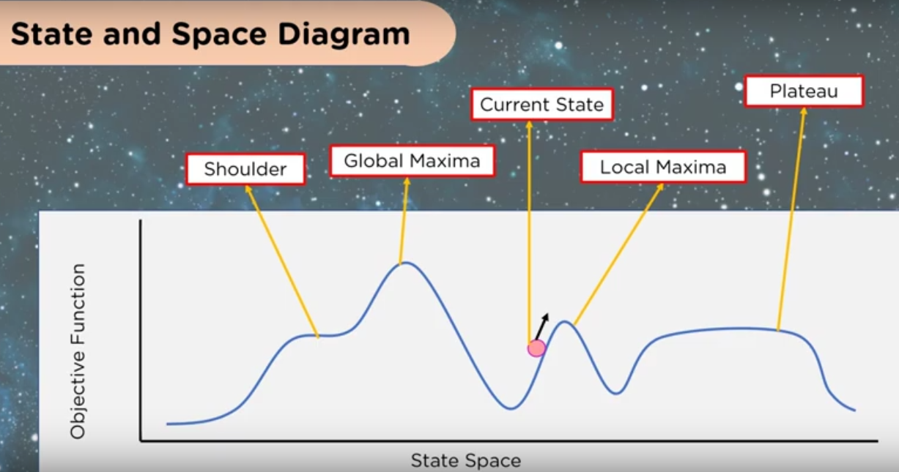
Hill Climbing

Slide 95
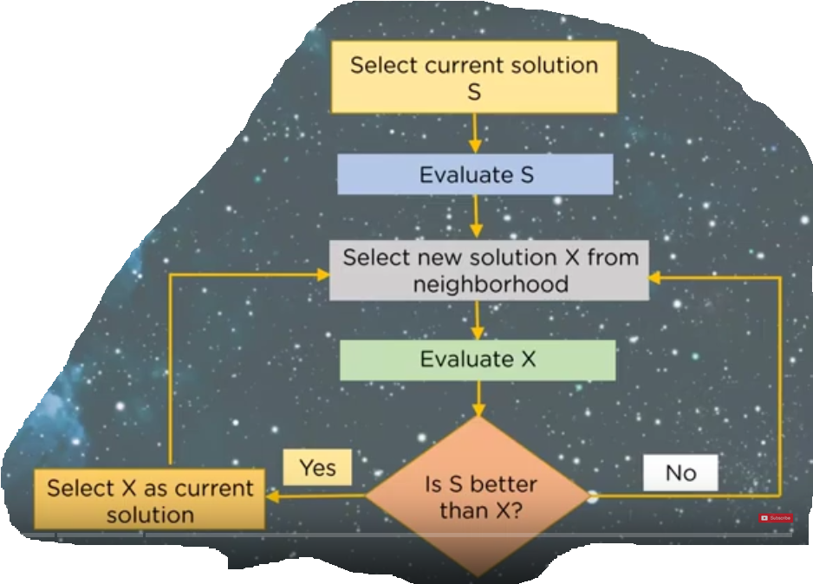
Hill Climbing

Slide 96
Hill Climbing
Hill climbing algorithm is a local search algorithm which continuously moves in the direction of increasing elevation/value to find the peak of the mountain or best solution to the problem.
It terminates when it reaches a peak value where no neighbor has a higher value.
Hill climbing algorithm is a technique which is used for optimizing the mathematical problems.
One of the widely discussed examples of Hill climbing algorithm is Traveling-salesman Problem in which we need to minimize the distance traveled by the salesman.

Slide 97
Hill Climbing
It is also called greedy local search as it only looks to its good immediate neighbor state and not beyond that.
A node of hill climbing algorithm has two components which are state and value.
In this algorithm, we don't need to maintain and handle the search tree or graph as it only keeps a single current state.

Slide 98
HC: Different regions in the state space landscape
Local Maximum: Local maximum is a state which is better than its neighbor states, but there is also another state which is higher than it.
Global Maximum: Global maximum is the best possible state of state space landscape. It has the highest value of objective function.
Current state: It is a state in a landscape diagram where an agent is currently present.
Flat local maximum: It is a flat space in the landscape where all the neighbor states of current states have the same value.
Shoulder: It is a plateau region which has an uphill edge.

Slide 99
Features of Hill Climbing
Following are some main features of Hill Climbing Algorithm:
Generate and Test variant: Hill Climbing is the variant of Generate and Test method. The Generate and Test method produce feedback which helps to decide which direction to move in the search space.
Greedy approach: Hill-climbing algorithm search moves in the direction which optimizes the cost.
No backtracking: It does not backtrack the search space, as it does not remember the previous states.

Slide 100
Heuristics Function …h(n)
Heuristic is a function which is used in Informed Search, and it finds the most promising path.
It takes the current state of the agent as its input and produces the estimation of how close agent is from the goal.
The heuristic method, however, might not always give the best solution, but it guaranteed to find a good solution in reasonable time.
Heuristic function estimates how close a state is to the goal. It is represented by h(n), and it calculates the cost of an optimal path between the pair of states.
The value of the heuristic function is always positive.
h(n) <= h*(n)
Here h(n) is heuristic cost, and h*(n) is the estimated cost. Hence heuristic cost should be less than or equal to the estimated cost.

Slide 101
Best-First Search
Greedy best-first search algorithm always selects the path which appears best at that moment.
It is the combination of depth-first search and breadth-first search algorithms.
It uses the heuristic function and search.
Best-first search allows us to take the advantages of both algorithms.
With the help of best-first search, at each step, we can choose the most promising node.

Slide 102
Best-First Search
In the best first search algorithm, we expand the node which is closest to the goal node and the closest cost is estimated by heuristic function, i.e.
f(n)= h(n)
Where, h(n)= estimated cost from node n to the goal.

Slide 103
Generic Best-First Search
Step 1: Place the starting node into the OPEN list.
Step 2: If the OPEN list is empty, Stop and return failure.
Step 3: Remove the node n, from the OPEN list which has the lowest value of h(n), and places it in the CLOSED list.
Step 4: Expand the node n, and generate the successors of node n.
Step 5: Check each successor of node n, and find whether any node is a goal node or not. If any successor node is goal node, then return success and terminate the search, else proceed to Step 6.
Step 6: For each successor node, algorithm checks for evaluation function f(n), and then check if the node has been in either OPEN or CLOSED list. If the node has not been in both list, then add it to the OPEN list.
Step 7: Return to Step 2.

Slide 104
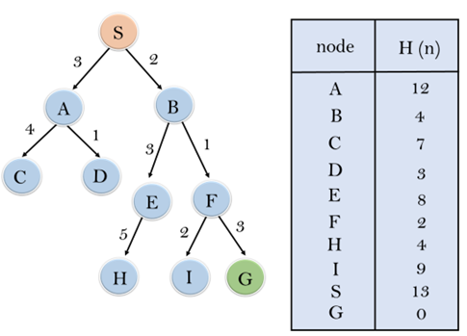
Generic Best-First Search
Consider the below search problem, and we will traverse it using greedy best-first search. At each iteration, each node is expanded using evaluation function f(n)=h(n) ,
which is given in
the table.

Slide 105
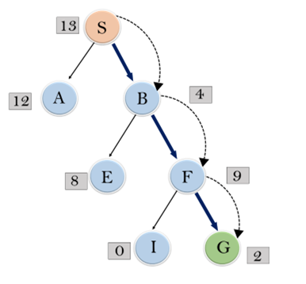
Generic Best-First Search
In this search example, we are using two lists which are OPEN and CLOSED Lists.
Following are the iteration for traversing the above example.

Slide 106
Generic Best-First Search
Expand the nodes of S and put in the CLOSED list
Initialization: Open [A, B], Closed [S]
Iteration 1: Open [A], Closed [S, B]
Iteration 2: Open [E, F, A], Closed [S, B] : Open [E, A], Closed [S, B, F]
Iteration 3: Open [I, G, E, A], Closed [S, B, F] : Open [I, E, A], Closed [S, B, F, G]
Hence the final solution path will be:
S----> B----->F----> G

Slide 107
A* Search
A* search is the most commonly known form of best-first search. It uses heuristic function h(n), and cost to reach the node n from the start state g(n).
It has combined features of UCS and greedy best-first search, by which it solve the problem efficiently. A* search algorithm finds the shortest path through the search space using the heuristic function.
This search algorithm expands less search tree and provides optimal result faster. A* algorithm is similar to UCS except that it uses g(n)+h(n) instead of g(n).

Slide 108
A* Search
A* search algorithm finds the shortest path through the search space using the heuristic function.
This search algorithm expands less search tree and provides optimal result faster.
In A* search algorithm, we use search heuristic as well as the cost to reach the node.
Hence we can combine both costs as following, and this sum is called as a fitness number.

Slide 109
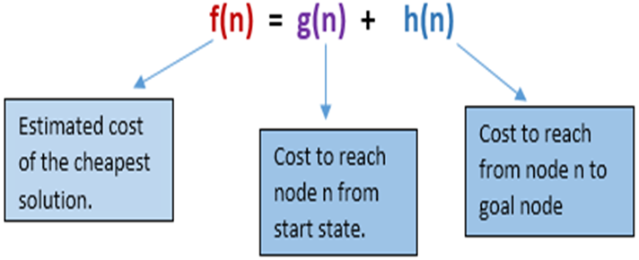
A* Search
In A* search algorithm, we use search heuristic as well as the cost to reach the node. Hence we can combine both costs as following, and this sum is called as a fitness number [f(n)].
A* algorithm uses g(n)+h(n) unlike use of g(n) in other search algorithms.
Used mainly in
Games and Web-
Based Maps

Slide 110
Algorithm of A* Search
Step1: Place the starting node in the OPEN list.
Step 2: Check if the OPEN list is empty or not, if the list is empty then return failure and stops.
Step 3: Select the node from the OPEN list which has the smallest value of evaluation function (g+h), if node n is goal node then return success and stop, otherwise
Step 4: Expand node n and generate all of its successors, and put n into the closed list. For each successor n', check whether n' is already in the OPEN or CLOSED list, if not then compute evaluation function for n' and place into Open list.
Step 5: Else if node n' is already in OPEN and CLOSED, then it should be attached to the back pointer which reflects the lowest g(n') value.
Step 6: Return to Step 2.

Slide 111
A* Search: Example
In this example, we will traverse the given graph using the A* algorithm. The heuristic value of all states is given in the below table so we will calculate the f(n) of each state using the formula of fitness number
f(n)= g(n) + h(n)
where g(n) is the cost to reach any node from
start state
h(n) is the cost to reach from node n to goal node
Here we will use OPEN and CLOSED list.

Slide 112
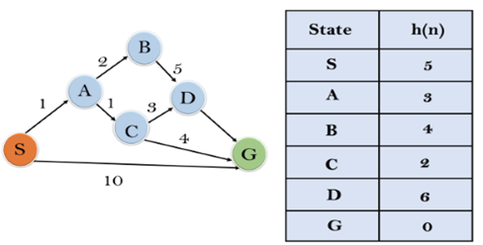
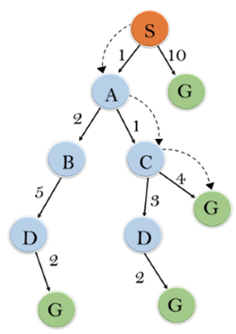
A* Search: Example use f(n)= g(n) + h(n)
Initialization: {(S, 5)}
S => 0 + 5 = 5
Iteration1:
S--> A => 1+3= 4
S-->G => 10+0= 10
Iteration2:
S--> A-->C =>
1+1+2 = 4
S--> A-->B =>
1+2+4 = 7

Slide 113
A* Search: Example
Iteration3:
S--> A-->C--->G =>
1+1+4+0 =6
S--> A-->C--->D =>
1+1+3+6= 11
Iteration 4 will give the final result, as S--->A--->C--->G it provides the optimal path with cost 6.

Slide 114
References
https://www.javatpoint.com/artificial-intelligence-tutorial
https://www.youtube.com/watch?v=PzEWHH2v3TE
Artificial Intelligence: A Modern Approach
by Stuart Russell and Peter Norvig
http://aima.cs.berkeley.edu/figures.pdf
END

